Slide 1


Introduction to
Robotic Process Automation
VIRTUAL NETWORK ASSISTANT
Register No:220701018
Name:AJAY KRISHNAN
Guide Name:mrs.Jinu Sophia
Designation and Department:Assistant Prof/CSE

Slide 2
Abstract
The Virtual Networking Assistant is an innovative Robotic Process Automation (RPA)
project developed using UiPath Studio, designed to help users build professional networks
and explore career opportunities. This tool provides a streamlined and automated approach to networking by interacting with users through intuitive input dialogs and delivering tailored
guidance. The workflow begins with an input dialog offering two options: "Guidance to
Get a Job: Tips to Build a Network" and "How to Network with Professionals."
Selecting the first option provides actionable insights into crafting effective networking
strategies, with a focus on job-seeking tips and leveraging connections. The workflow then
prompts users to "Enter your education or skills," enabling the assistant to generate
personalized recommendations. Choosing the second option offers practical advice on
connecting and engaging with professionals, helping users build meaningful and lasting
relationships in their field

Slide 3
Need for the Proposed System
The proposed system introduces an automated solution using UiPath to streamline the form-filling process. The Form-Filling Bot extracts data from structured sources like databases and accurately populates fields in web-based or desktop forms. The bot handles scenarios, such as missing or incorrect data, and generates real-time status reports for form submission. By automating this workflow, the system reduces manual effort reduce errors, and ensures faster, more accurate form submissions. Additionally, with UiPath Orchestrator, the bot can be scheduled to run autonomously, improving efficiency and consistency across large-scale or recurring tasks. The proposed system also includes a logging mechanism to track the success or failure of each task, providing transparency accountability. By automating the entire process, the system enhances productivity, operational costs, and ensures timely completion of tasks, making it a reliable solution for businesses with high-volume form-filling needs.

Slide 4
Advantages of the Proposed System
1.Automates the job of form filling which reduces time.
2.Reduces manual error and typing error.
3.Large sets of data can be entered without heavy workload.
4.confirmation of the submission of form by receiving the mail
acknowledgement.

Slide 5
Literature Survey
1.Wang, S., Zou, Y., Keivanloo, I.,
Upahyaya, B. and Ng, J. (2017) ‘An intelligent framework for auto-filling web forms from
different web applications’, Int. J. Business Process Integration and Management, Vol. 8, No. 1,
pp.16–30.
ADVANTAGES:
1.Efficiency and automation.
2.Accuracy in standardised tasks.
DISADVANTAGES:
1.Data integrity issues.
2.Security risks.

Slide 6
Main Objective
The Form-Filling Bot is an automation solution developed using UiPath for data entry processes. It eliminates repetitive manual tasks by extracting data from sources like Excel or databases and populating forms accurately. This project enhances efficiency, reduces errors, and demonstrates the potential of RPA in optimizing routine administrative workflows. It eliminates repetitive manual tasks by extracting data from sources like Excel or databases and populating forms accurately.This also helps us to know the status of the form submission via email acknowledgement.

Slide 7
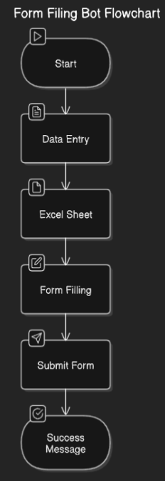
Architecture

Slide 8
System Requirements
Hardware
1.A device with uipath studio.
2.Network connection.
Software
1.uipath studio.

Slide 9
Functional Description
Form Population: Once the data is validated, the bot automatically fills the fields of web-based or desktop forms. It eliminates manual typing, ensuring that data is entered without errors.
Report Generation: After form submission, the bot generates detailed status reports, summarizing the results of the form-filling process and any errors encountered. These are saved for further reference and analysis.

Slide 10
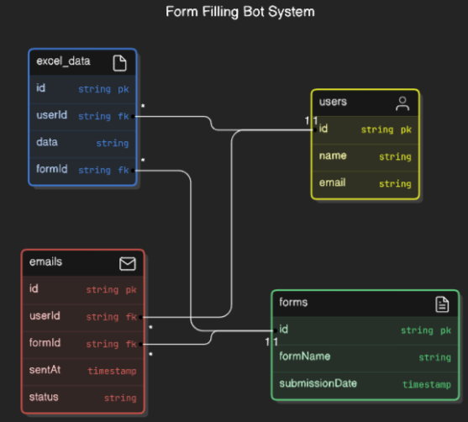
Table Design

Slide 11
Process Design
Main Process
To submit the form by importing the details from the excel sheet and after submitting the form the user gets the mail that the form has been submitted successfully.
sub process
use excel related activities to import the data from the excel to the form and use the click activity to specify the fields in which the data to be entered and also the submit button and use the smtp activity to receive the mail message and finally a message box to display the success message.

Slide 12
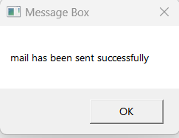
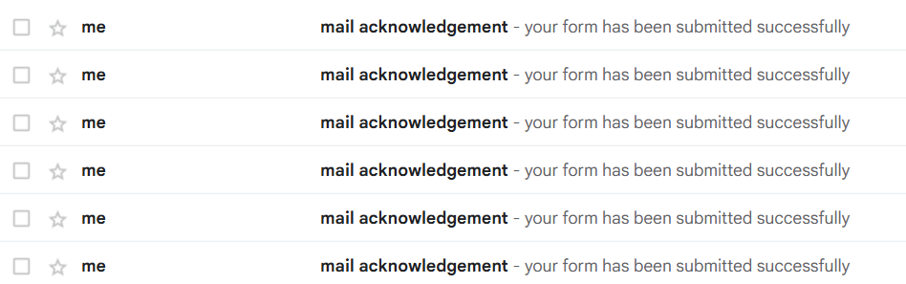
Testing

Slide 13
Conclusions
The Form-Filling Bot project successfully automates the data entry and form submission process, significantly improving efficiency and accuracy in handling repetitive tasks. By leveraging UiPath's Robotic Process Automation (RPA) technology, the bot extracts data, fills forms, handles errors, and generates reports, eliminating manual intervention. This automation not only reduces human errors but also saves time, cuts costs, and enhances operational productivity. The system’s integration with email notifications and database storage further streamlines communication and record-keeping. Ultimately, the Form-Filling Bot provides a reliable, scalable, and cost-effective solution for businesses seeking to optimize their workflow. By leveraging UiPath's Robotic Process Automation (RPA) technology, the bot extracts data, fills forms, handles errors, and generates reports, eliminating manual intervention. This automation not only reduces human errors but also saves time, cuts costs, and enhances operational productivity. The system’s integration with email notifications and database storage further streamlines communication and record- keeping.

Slide 14
Future Enhancement
1. Integration with AI/ML
2. Enhanced Bot Detection.
3. Security Measures.
4. User Experience Improvements
5.Multi-Language Support

Slide 15
References
1. Avasarala, V. (2019). Robotic Process Automation: The Next Transformation in Digital Transformation. International Journal of Advanced Research in Computer Science, 10(3), 5-12.
2. Lacity, M. C., & Willcocks, L. P. (2016). A Survey on Robotic Process Automation in Business. Journal of Information Technology, 31(2), 174- 183.

Slide 16
Queries

Slide 17
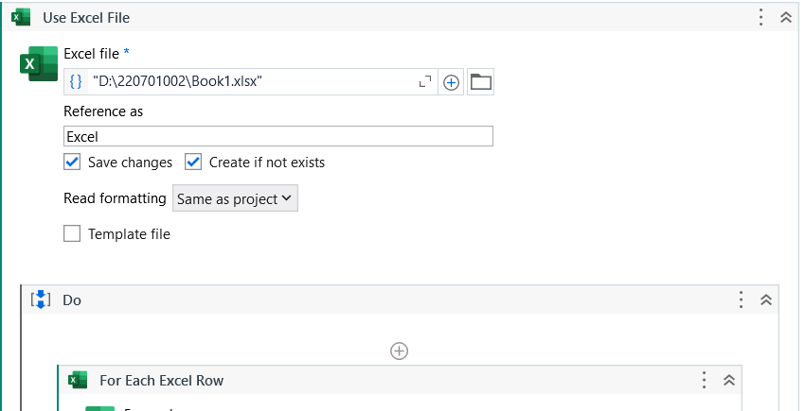
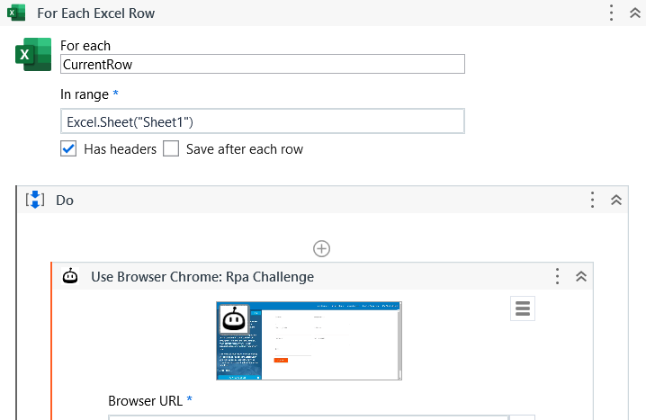
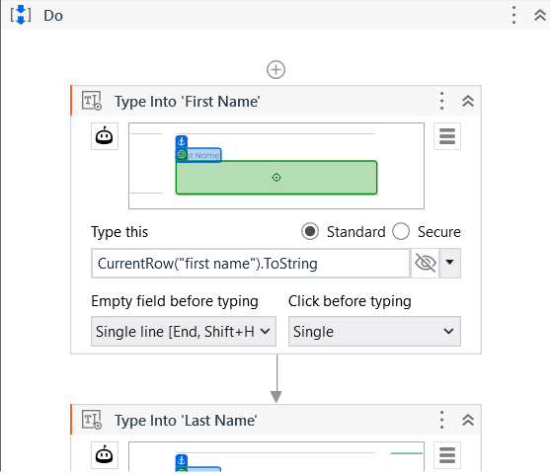
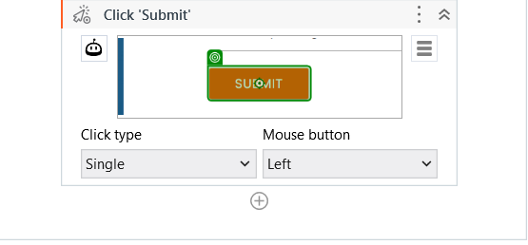

Slide 18
Thank You

